Slide 3
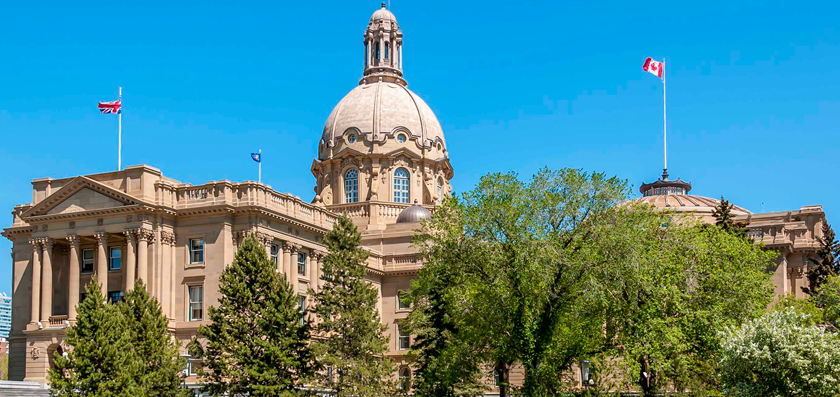
Rally for Public Education
Plan to arrive between noon and 12:45 p.m.
Listen to live music and enjoy fare from several local food trucks.
Sign-making supplies will be available for you to make your own sign, or plan to pick up one of the Stand for Education lawn signs to hold during the rally.

Slide 4
Rally for Public Education
Sign-making supplies will be available for you to make your own sign, or plan to pick up one of the Stand for Education lawn signs to hold during the rally.

Slide 5
Rally program begins at 1 p.m. The official program will run from 1 to 2 p.m. on the north side of the legislature building.
There will be inspiring speakers, great musicians and dynamic poets who will amplify the voices of teachers, parents and all those who are advocating for public education and the future of our children.

Slide 6
Rally for Public Education
The event will be hosted by Dr. Carla Peck, a prominent champion of public education and University of Alberta professor.

Slide 7
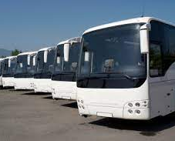
Getting to the rally
Various ATA locals around the province are arranging charter buses to travel to Edmonton on Oct. 22.
Teachers and parents (with children) are welcome to sign up to ride on one of these buses by visiting the appropriate Eventbrite page.
Calgary Catholic Teachers Local 55
https://www.eventbrite.ca/e/423865943447
Calgary Public Teachers Local 38
https://www.eventbrite.ca/e/stand-for-public-education-rally-tickets-422924818517
Other locals
https://www.eventbrite.ca/e/stand-for-education-public-rally-charter-bus-registration-tickets-420534749757
Buses will arrive at the legislature between noon and 12:30 p.m.

Slide 8
There will be no parking available in downtown Edmonton, as there is an Oilers' hockey game taking place that same afternoon.
For attendees who live in the Edmonton area, or who will be driving themselves, free park-and-ride buses will leave for the rally from four Edmonton locations between 11:15 a.m. and 12:15 p.m. See the back page for a map and details.

Slide 9
“This rally is our chance to create a new narrative about what we want to see for public education, now and in the future. This is our moment” ATA president Jason Schilling.

Slide 10
What can you do?
talk to your colleagues

Slide 11
What can you do?
Talk to parents – especially those on your school council
This rally is co-sponsored by the Alberta School Councils Assocaiton

Slide 12
What can you do?
Register to attend at Standforeducation.ca and encourage others to do so as well

Slide 13
What can you do?
Share the rally information on social media

Slide 14
What can you do?
Make a Tik Tok video about why you are attending – watch it go viral…

Slide 15
What can you do?
Attend the rally

Slide 16
For more information about the rally contact your Local President

